Slide 1


Topological Data Analysis on Music Data
Team Members: Siddhant Ranade – u1141131, Yash Gangrade – u1143811
April 29, 2019
Presented By:
Siddhant Ranade
PhD in Computer Science
University of Utah

Slide 2

Outline
Background and Motivation
Proposed Tasks
Methodology
Results
Conclusion
Future Scope of Research

Slide 3
Background and Motivation
Music in general is rich in structures. Songs can be viewed as combination of different channels and each channel can be considered as a combination of notes.
If one looks at the sequence of notes that make up a song, one can usually find repeating patterns, for instance, verses will often have exactly the same tune. Observing carefully, it can be observed that certain phrases (or shorter sequence of notes) occur more frequently.
Notes can be perceived as lying on a circle. Distance between the notes is defined by finding the distances between equivalent nodes (in terms of frequencies).

Slide 4
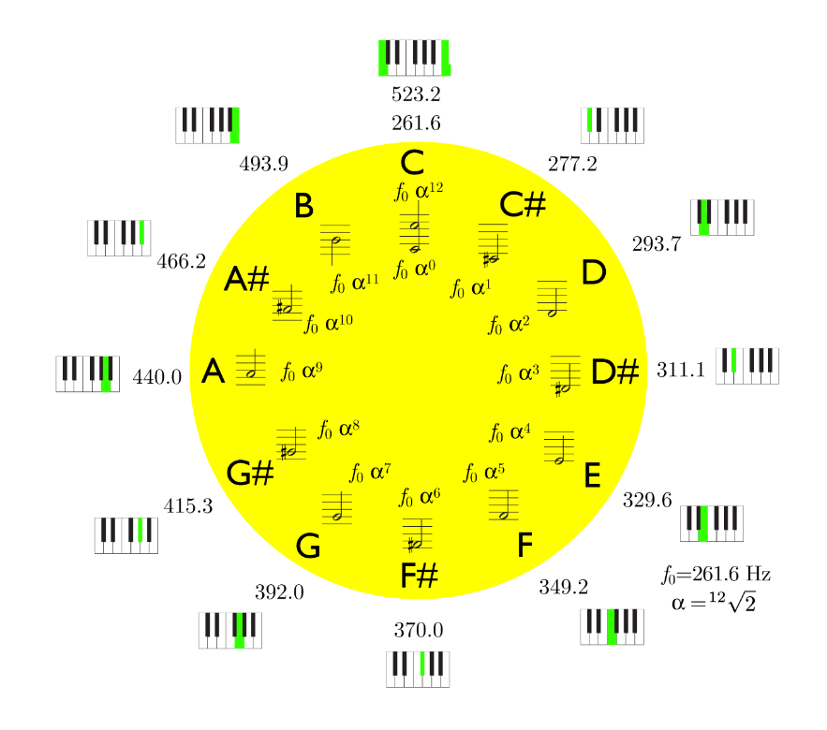
Background and Motivation
Fig. 1: Circle of Notes*
*Source: Sethares et al., Topology of Musical Data

Slide 5
Outline
Background and Motivation ☑
Proposed Tasks
Methodology
Results
Conclusion
Future Scope of Research

Slide 6
Proposed Tasks
Explore topological structures of data
Genre Classification
Artist Identification
Comparison of Musical Styles. Ex. Classical vs Pop
Identification of 4-chord progression

Slide 7
Outline
Background and Motivation ☑
Proposed Tasks ☑
Methodology
Results
Conclusion
Future Scope of Research

Slide 8
Work done so far..
Significant progress in data collection pipeline. It includes downloading the required midi version of a song and extracting appropriate channels from it.
Point cloud extraction: Single-note embedding (extract a set of all the notes in the song) and Time-series embedding (extract a set of all note sequences of length N).
Compute the distance matrix for the specific class of point-cloud being used, as input to ripser for computation of persistence diagrams/barcodes.
Apply Bottleneck and Wasserstein distance measures to compute the dissimilarity between the persistence diagrams and plotting them using TSNE.

Slide 9
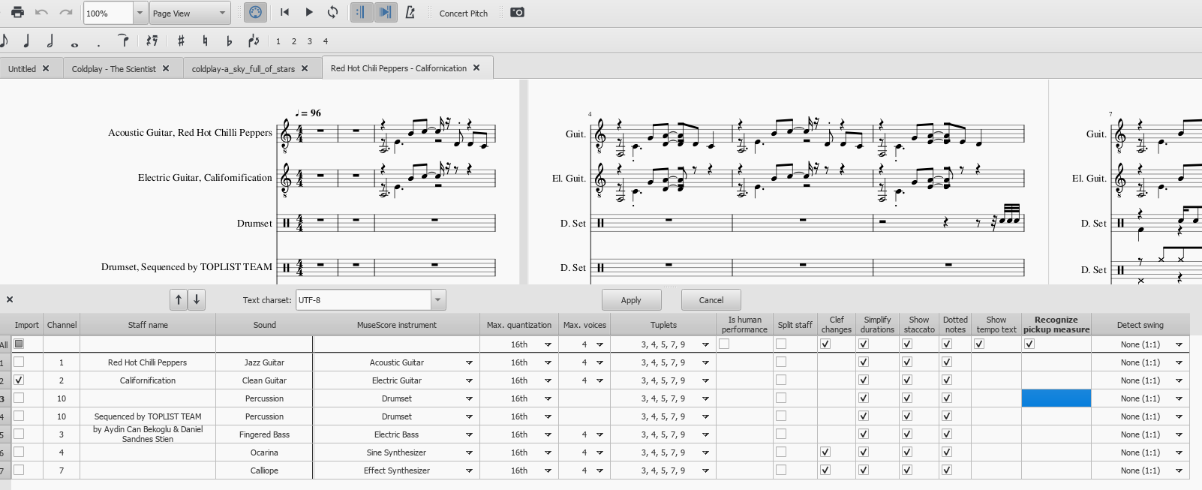
Procedure: Data Collection Pipeline

Slide 10
Outline
Background and Motivation ☑
Proposed Tasks ☑
Methodology ☑
Results
Conclusion
Future Scope of Research

Slide 11
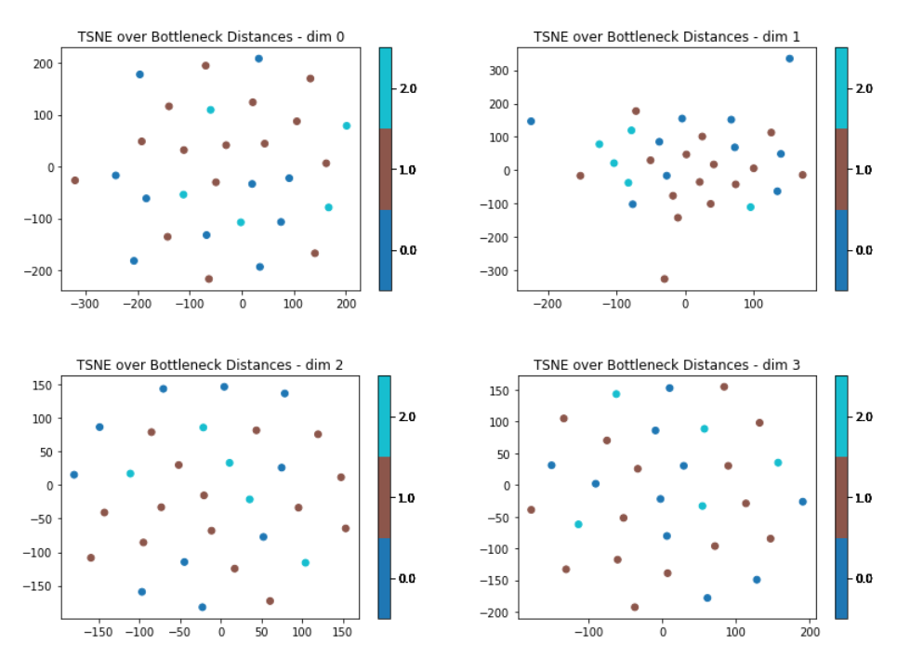
Results: Persistence Diagram Distances

Slide 12
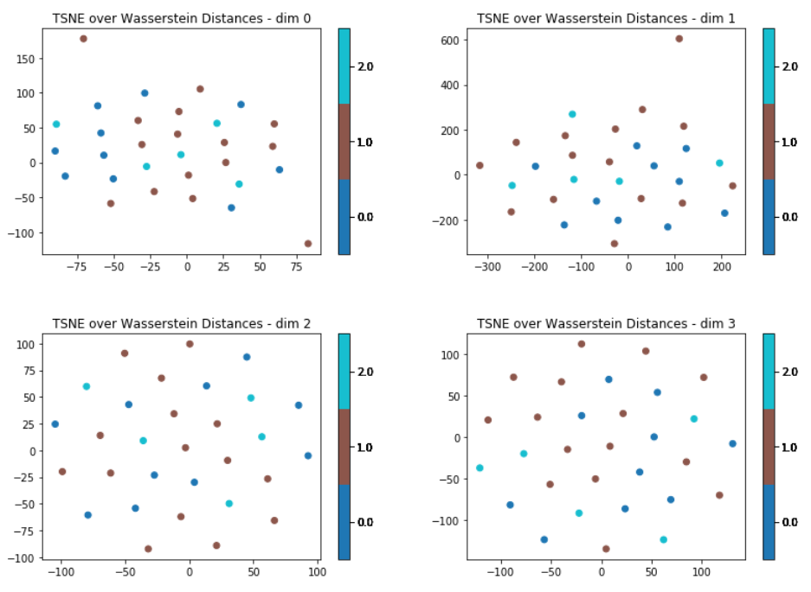
Results: Persistence Diagram Distances

Slide 13
Outline
Background and Motivation ☑
Proposed Tasks ☑
Methodology ☑
Results ☑
Conclusion
Future Scope of Research

Slide 14
Conclusion

Slide 15
Outline
Background and Motivation ☑
Proposed Tasks ☑
Methodology ☑
Results ☑
Conclusion ☑
Future Scope of Research

Slide 16
Future Scope of Research
Implement chord-class (i.e. extract the set of all chords in the track) and chord-sequence embedding (i.e. extract the set of all sequences of chords of length N).
Formulating the distance measure for the above two embeddings.
Use machine learning algorithms along with neural networks for the artist and genre classification based on the songs.
Identifying the common chord progressions in popular music.

Slide 17
Upcoming Milestones
Implement chord-class (i.e. extract the set of all chords in the track) and chord-sequence embedding (i.e. extract the set of all sequences of chords of length N).
Formulating the distance measure for the above two embeddings.
Use machine learning algorithms along with neural networks for the artist and genre classification based on the songs.
Identifying the common chord progressions in popular music.

Slide 18
“
Thank you!
Questions?
“

